Slide 1
Simulation of FCC monocrystals
Emil Kalered
Ching-Chi Lin
Kristofer Krus
Lasse Hultberg

Slide 2
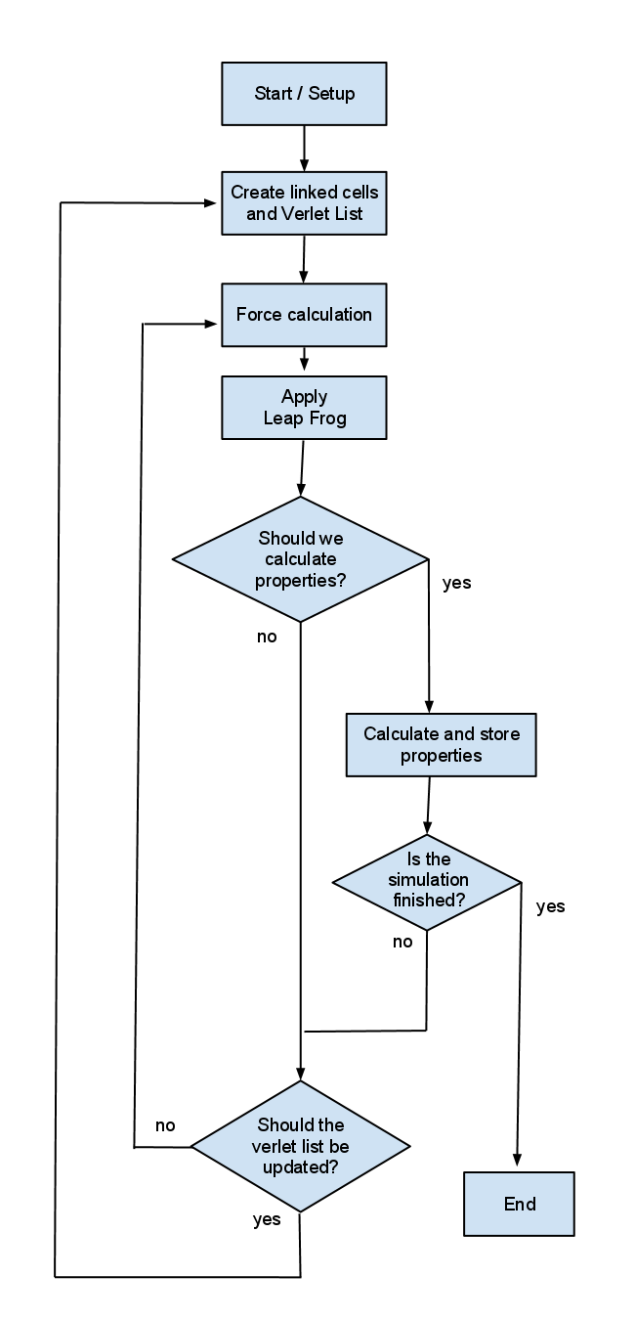
Flow chart

Slide 3
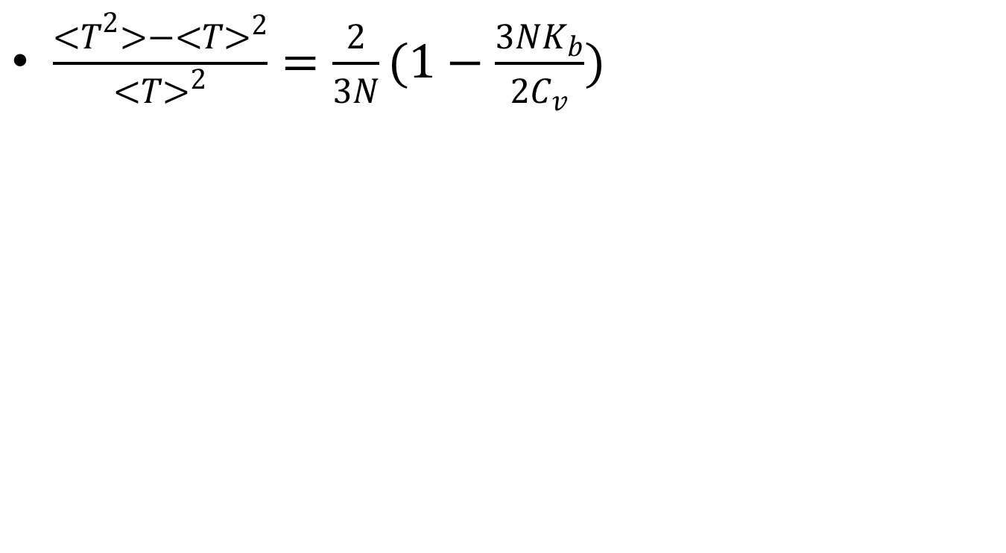
Specific heat
Element | Simulated values, J/(g*K) | Tabled values, J/(g*K) | Temperature, K
Silver | 0.233 | 0.233 | 293
Copper | 0.385 | 0.386 | 293
Xenon | 0.188 | 0.179 | 100
Argon | 0.607 | 0.55 | 60

Slide 4
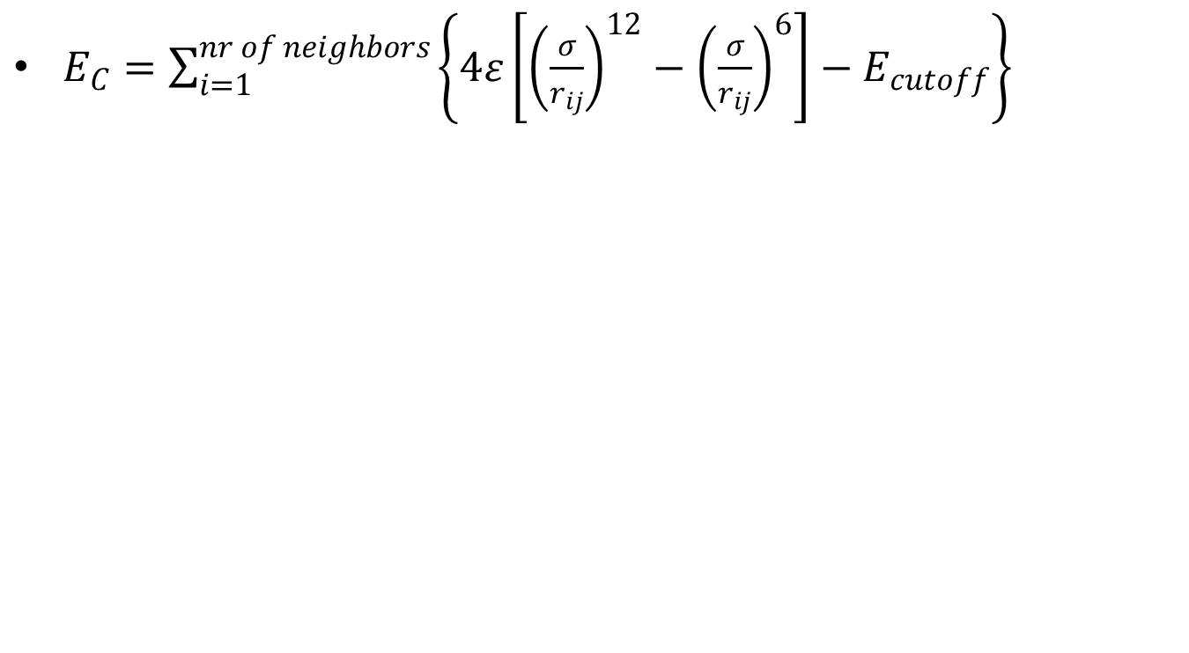
Cohesive energy
Element | Simulated values 1, eV/atom | Simulated values 2, eV/atom | Tabled values, eV/atom
Silver | 2.86 | 2.86 | 2.95
Copper | 3.44 | 3.44 | 3.49
Xenon | 0.17 | 0.17 | 0.16
Argon | 0.088 | 0.088 | 0.080

